Slide 1
Lecture 12
Visualization Starter Pack

Slide 2
Learning Objectives Today
General Matplotlib Tips
i. Styling ii. Saving iii. Multi-plot
Two Interfaces for the Price of One
Simple Line Plots
Simple Scatter Plots
Visualizing Errors

Slide 3
First things first
import matplotlib.pyplot as plt
Sometimes iPython may need
%matplotlib inline
import matplotlib as mpl
mpl.get_backend()

Slide 4
Styling Options
plt.style.use("classic")
plt.style.use("ggplot")
https://matplotlib.org/stable/gallery/style_sheets/style_sheets_reference.html

Slide 5
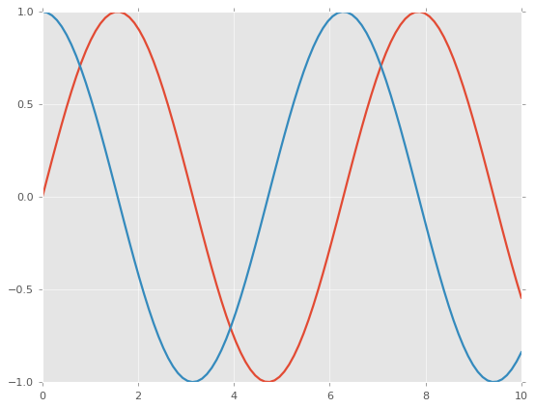
Sample
x = np.linspace(0, 10, 100)
plt.plot(x, np.sin(x))
plt.plot(x, np.cos(x))
plt.show()

Slide 6
Save the Image
from matplotlib.backends.backend_agg import FigureCanvasAgg
from matplotlib.figure import Figure\
fig = Figure()
canvas = FigureCanvasAgg(fig)
x = np.linspace(0, 10, 100)
ax = fig.add_subplot(111)
ax.plot(x, np.sin(x))
ax.plot(x, np.cos(x))
canvas.print_png('test.png')

Slide 7
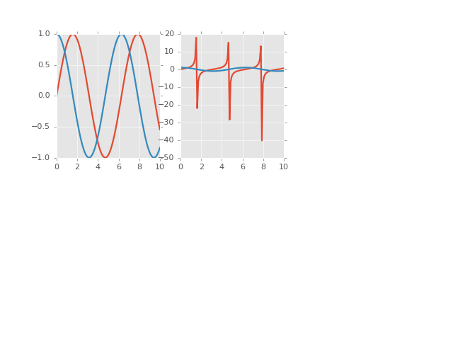
Multi-plot?
fig = Figure()
canvas = FigureCanvasAgg(fig)
x = np.linspace(0, 10, 100)
ax = fig.add_subplot(231)
ax.plot(x, np.sin(x))
ax.plot(x, np.cos(x))
ax = fig.add_subplot(232)
ax.plot(x, np.tan(x))
ax.plot(x, np.cos(x))
canvas.print_png('test2.png')

Slide 8
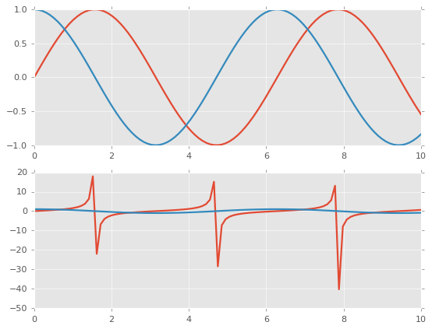
Another Style (OOP Style)
x = np.linspace(0, 10, 100)
fig, ax = plt.subplots(2)
ax[0].plot(x, np.sin(x))
ax[0].plot(x, np.cos(x))
ax[1].plot(x, np.tan(x))
ax[1].plot(x, np.cos(x))
fig.show()

Slide 9
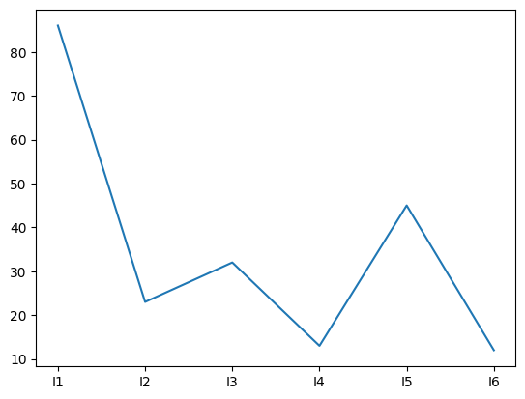
Line Plot
x = df['Model1']
plt.figure()
plt.plot(x, '-')

Slide 10
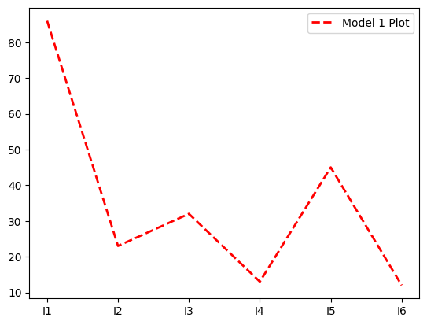
Styling
x = df['Model1']
plt.figure()
plt.plot(x, color='red', label='Model 1 Plot', linewidth=2, linestyle='--')
plt.legend()

Slide 11
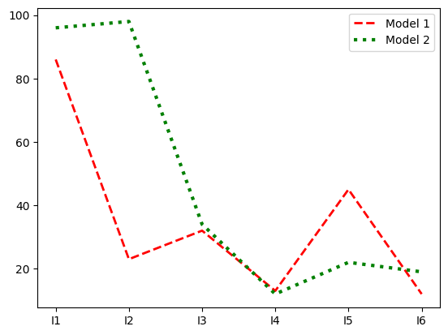
Ok Try Some More?
x = df['Model1']
y = df['Model2']
plt.figure()
plt.plot(x, color='red', label='Model 1', linewidth=2, linestyle='--’)
plt.plot(y, color='g', label='Model 2', linewidth=3, linestyle='dotted')
plt.legend()

Slide 12
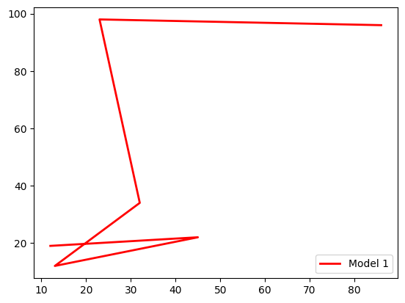
Against each-other?
x = df['Model1']
y = df['Model2']
plt.figure()
plt.plot(x, y, color='red', label='Model 1', linewidth=2, linestyle='--')
plt.legend()

Slide 13
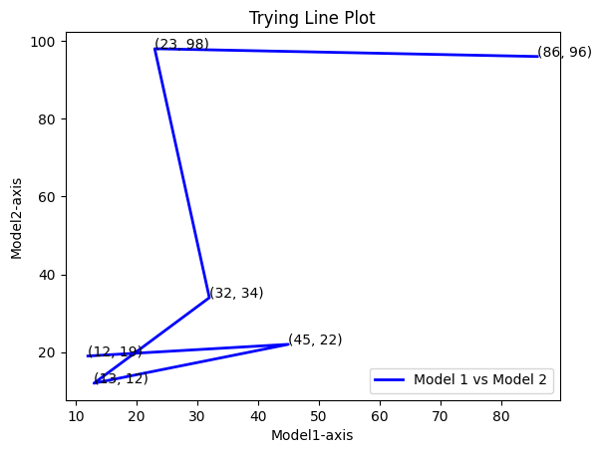
Axis, Title, Legend
x = df['Model1']
y = df['Model2']
plt.figure()
plt.plot(x, y, color='b', label='Model 1', linewidth=2, linestyle='solid')
plt.title("Trying Line Plot")
for i_x, i_y in zip(x, y):
plt.text(i_x, i_y, '({}, {})'.format(i_x, i_y))
plt.xlabel("Model1-axis")
plt.ylabel("Model2-axis")
plt.legend()

Slide 14
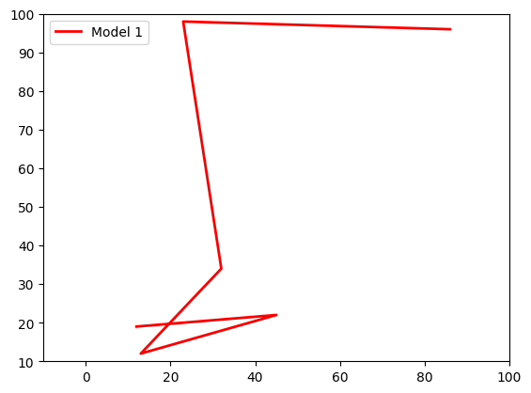
Axis Limit
x = df['Model1']
y = df['Model2']
plt.figure()
plt.plot(x, y, color='red', label='Model 1', linewidth=2, linestyle='solid')
plt.xlim(-10, 100)
plt.ylim(10, 100)
plt.legend()

Slide 15
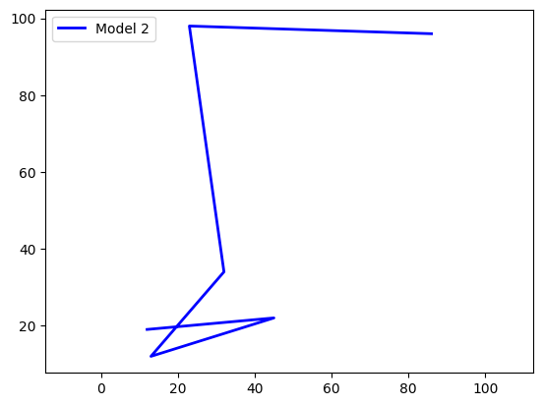
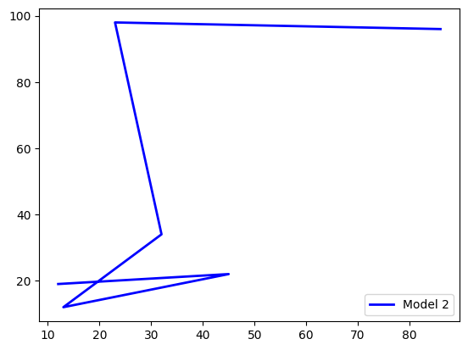
Axis Limit
plt.axis('tight’)
plt.axis(‘equal’)

Slide 16
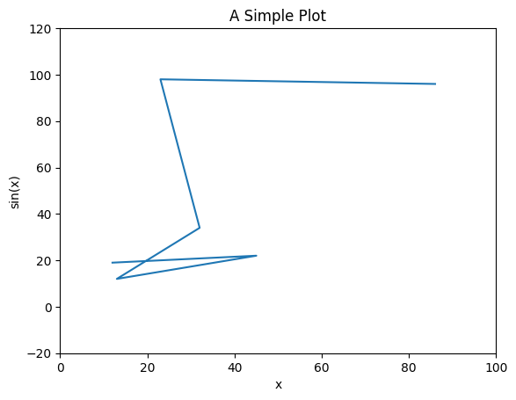
⚠️ OOP is stlightly different
ax = plt.axes()
ax.plot(x, y)
ax.set(xlim=(0, 100), ylim=(-20, 120),
xlabel='x', ylabel='sin(x)',
title='A Simple Plot');

Slide 17
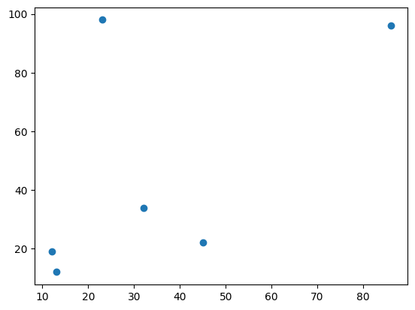
Scatter Plot
x = df['Model1']
y = df['Model2']
plt.figure()
plt.scatter(x, y)

Slide 18
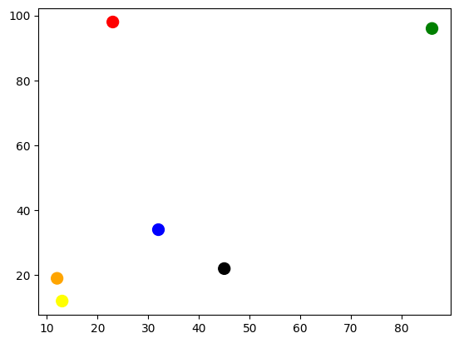
Styling
x = df['Model1']
y = df['Model2']
color = ['green', 'red', 'blue', 'yellow', 'black', 'orange']
plt.figure()
plt.scatter(x, y, s=100, c=color)

Slide 19
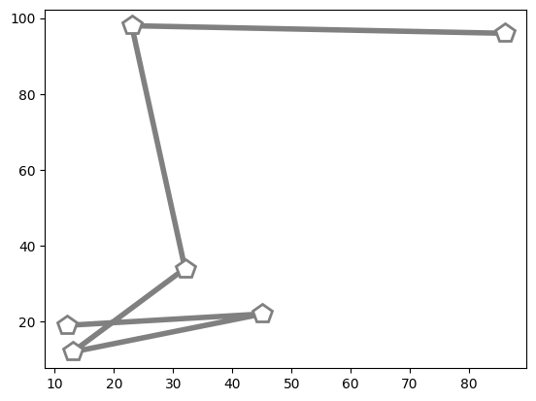
Scatter Plot using the “Plot”
plt.plot(x, y, '-p', color='gray',
markersize=15, linewidth=4,
markerfacecolor='white',
markeredgecolor='gray',
markeredgewidth=2)

Slide 20
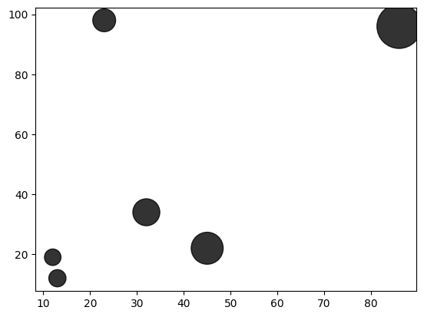
Intensity
plt.scatter(x, y, alpha=0.8, s=x*20, c='black', cmap='viridis')

Slide 21
Visualizing Errors
data = {'Model1': [10,12,32,45,67,72],'Error': [2,5,2,12,6,10]}
df = pd.DataFrame (data, columns = ['Model1','Error'], index=['I1', 'I2','I3','I4','I5','I6'])
x = df["Model1"]
y = df['Model2']
plt.errorbar(df.index, x, yerr=y, fmt=‘-ok’)

Slide 22
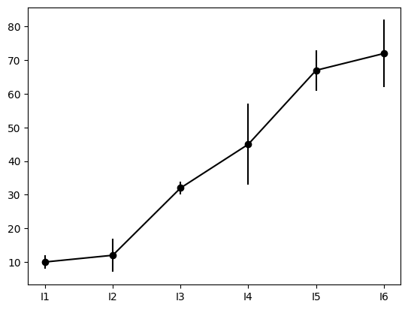
Errors

Slide 23
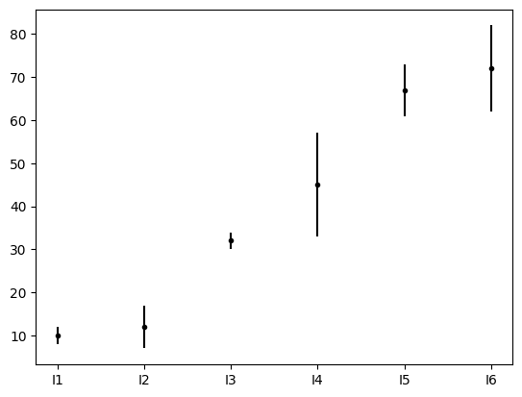
Styling (FMT parameter)
plt.errorbar(df.index, x, yerr=y, fmt='.k')

Slide 24
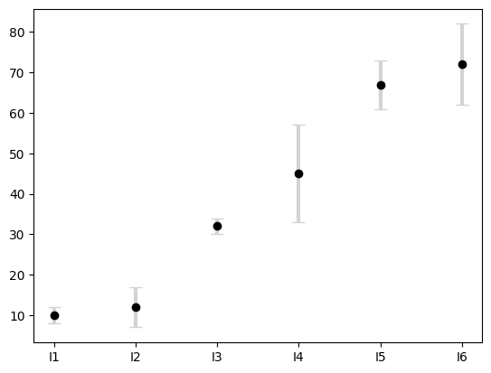
Styling
plt.errorbar(df.index, x, yerr=y, fmt='o', color='black',
ecolor='lightgray', elinewidth=3, capsize=5);

